Slide 1
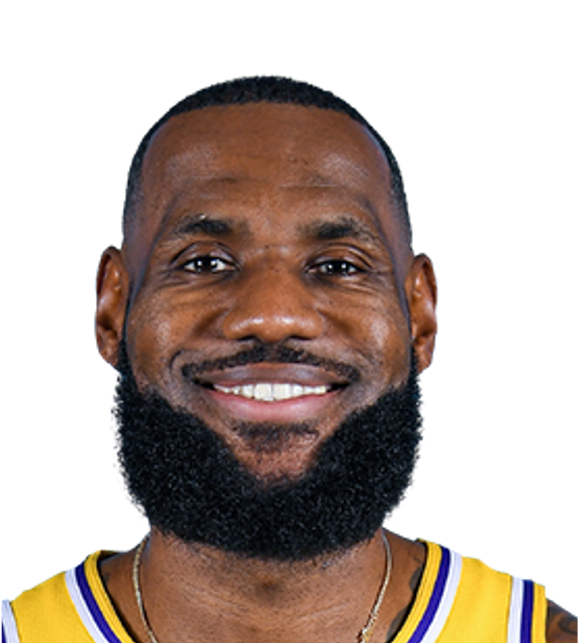
Auto Mini-hoop Scoring System
CE4172 Project
Wong Wei Bin U2022892D

Slide 2
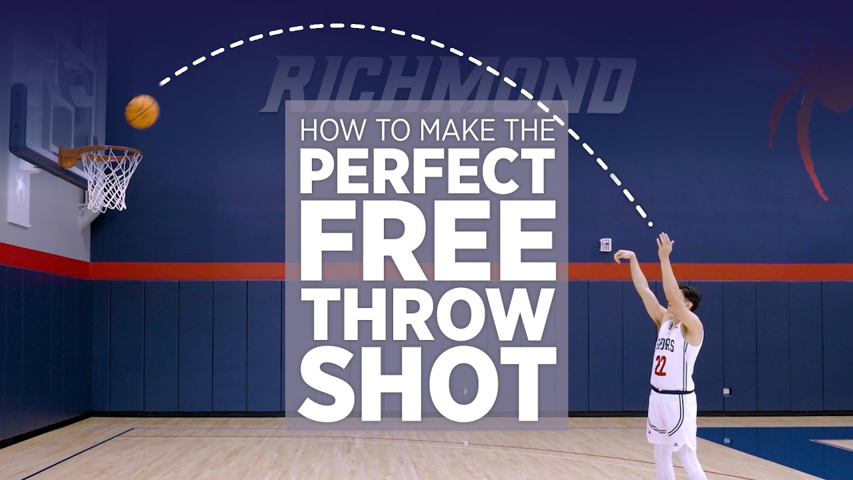

Problem
free throws
one person training
difficult to track :(
& get feedback for improvement

Slide 3

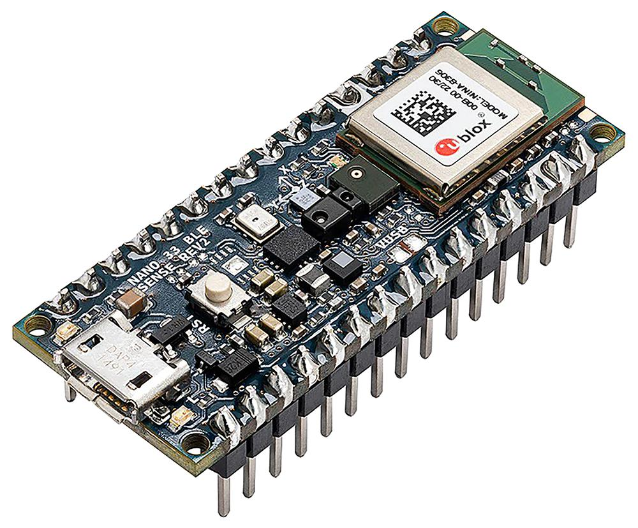

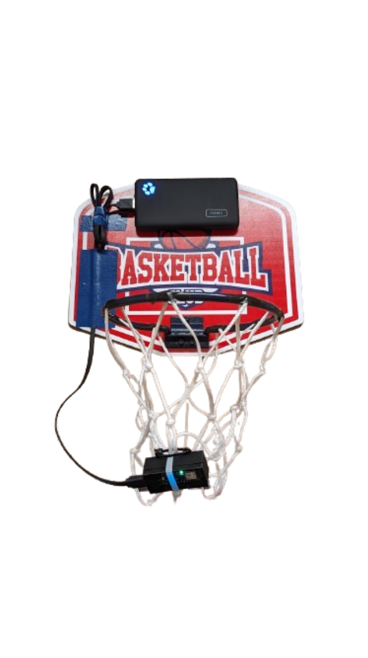
Solution

Slide 4
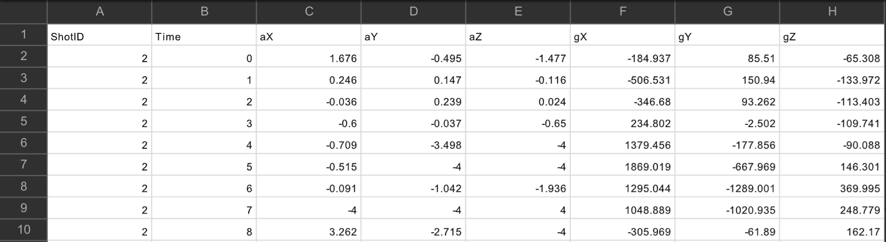
Data Collection
throw ball 200 times
score 100, miss 100
176 samples per shot, ~1.5s
arduino imu capture if > trigger threshold
python script to save to file depending on outcome

Slide 5
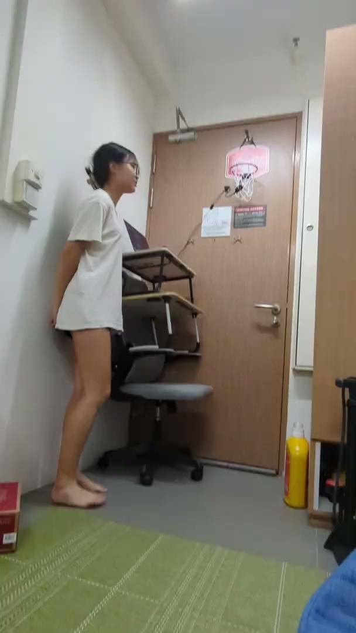

Data Collection

Slide 6
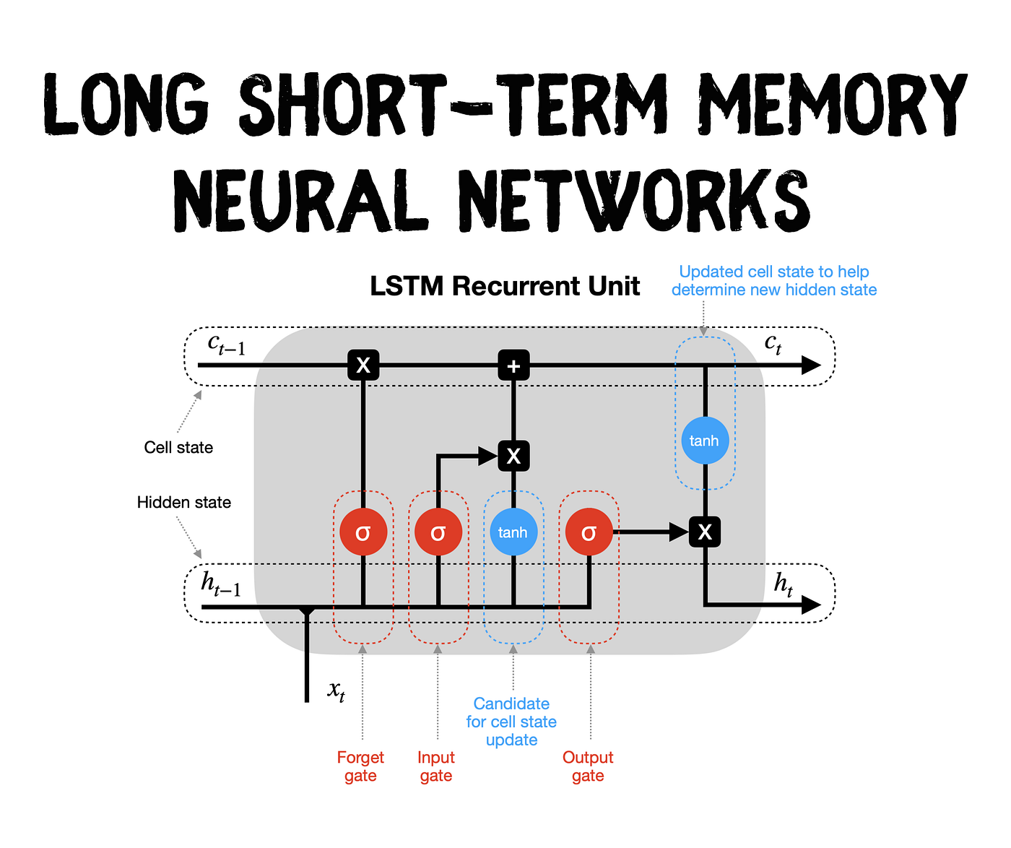
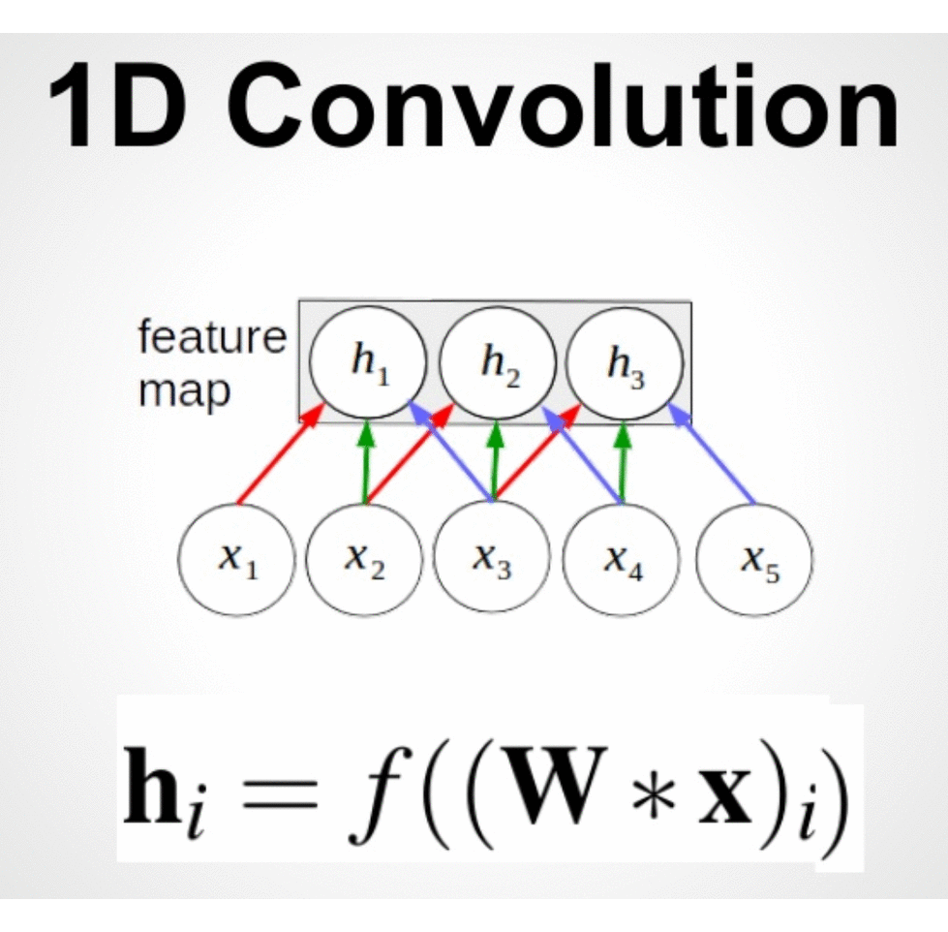
Model Selection & Training
VS

Slide 7
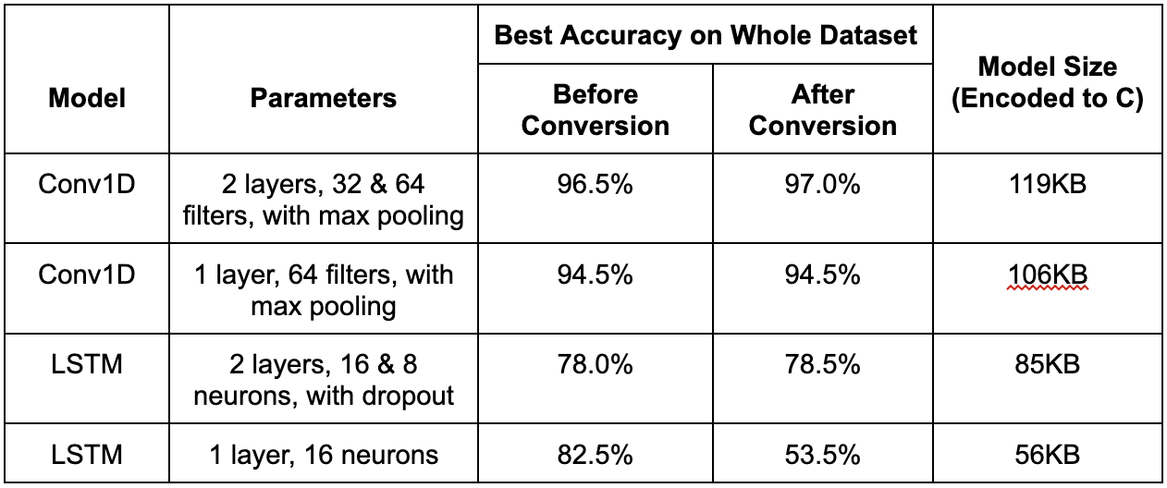
Model Selection & Training

Slide 8


Model Selection & Training
VS

Slide 9
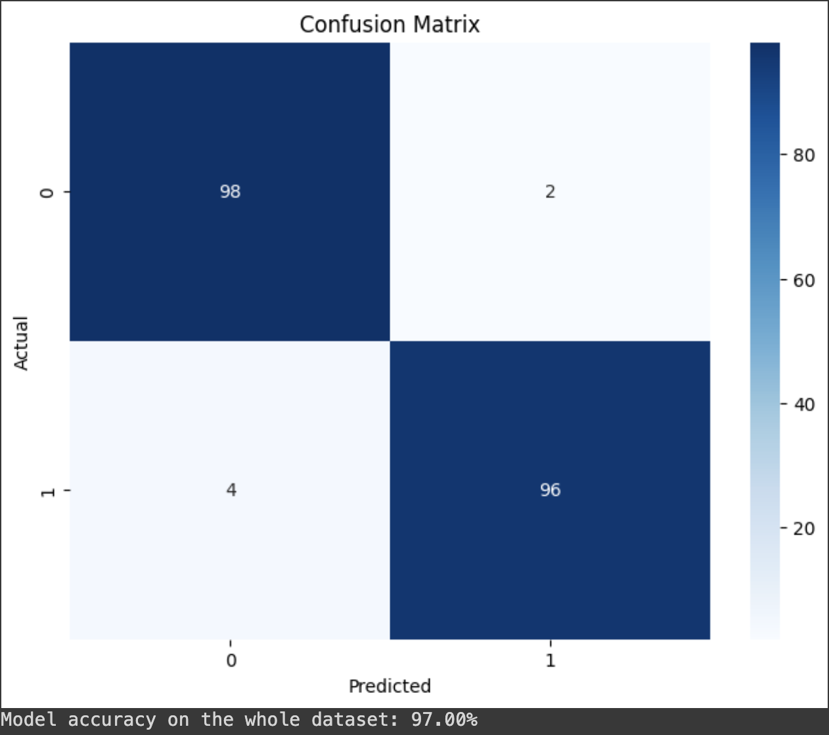
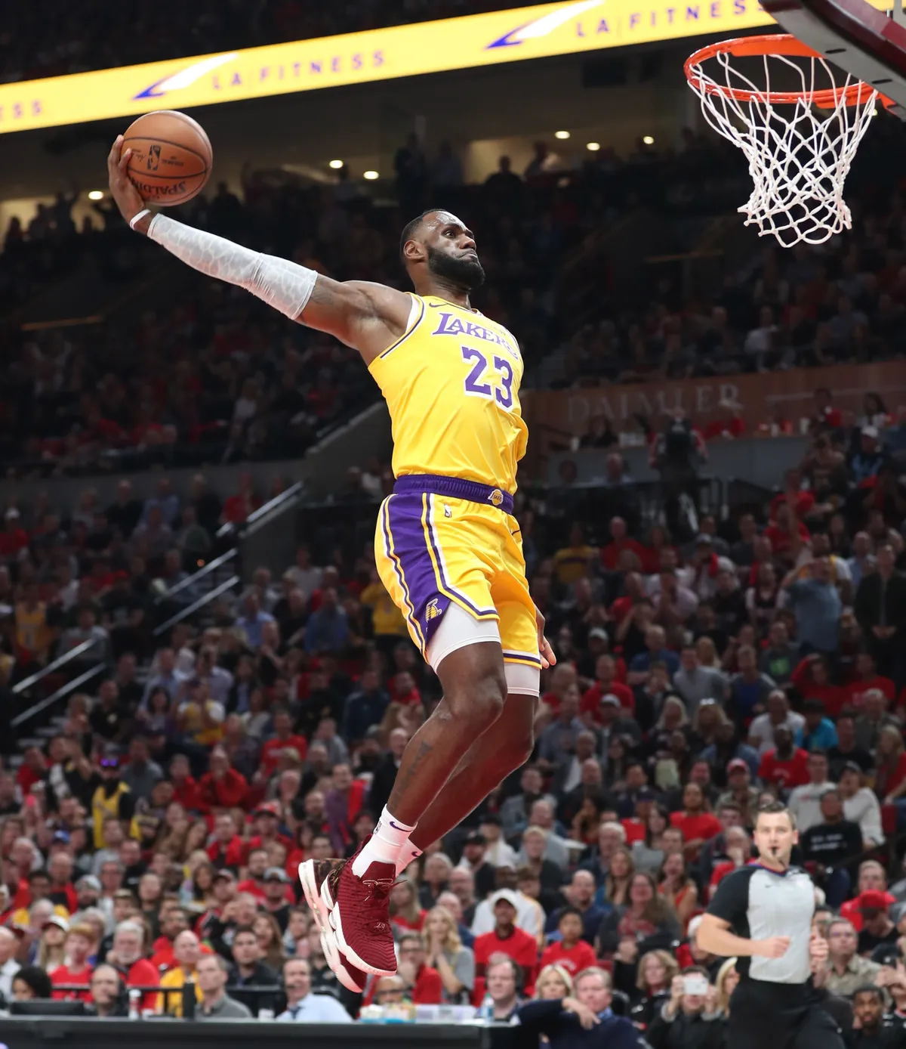

Conv1D Model Integration
97% Accuracy!! (in theory)

Slide 10
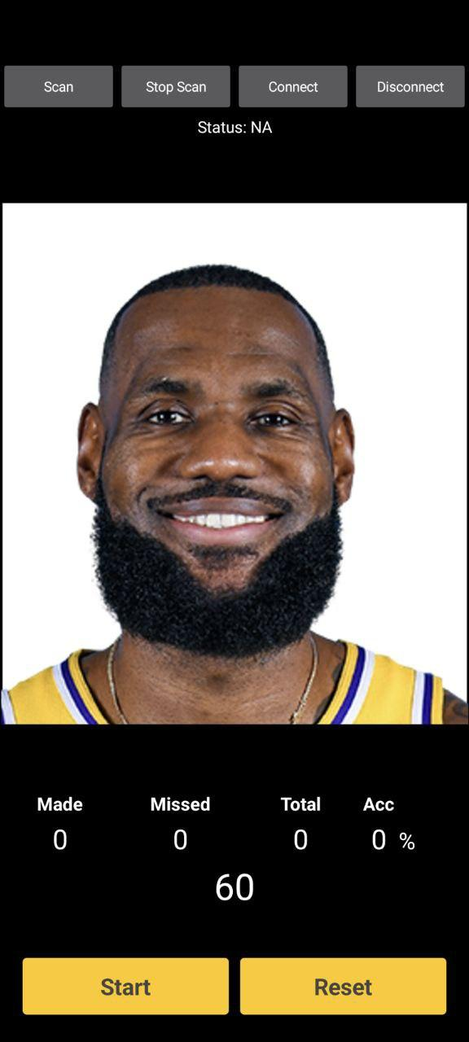

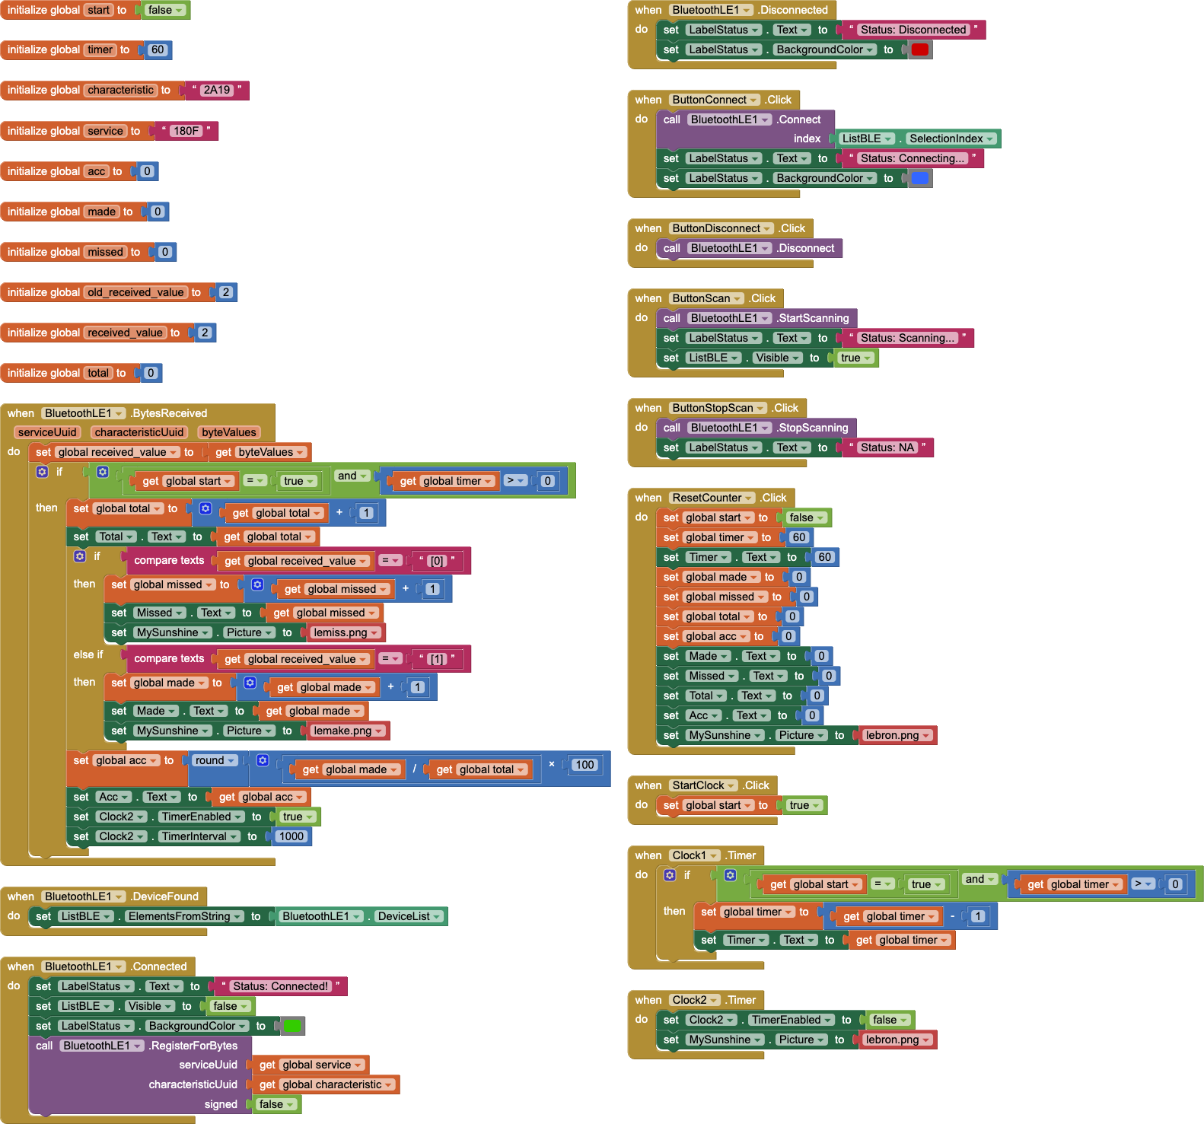

Android App UI

Slide 11
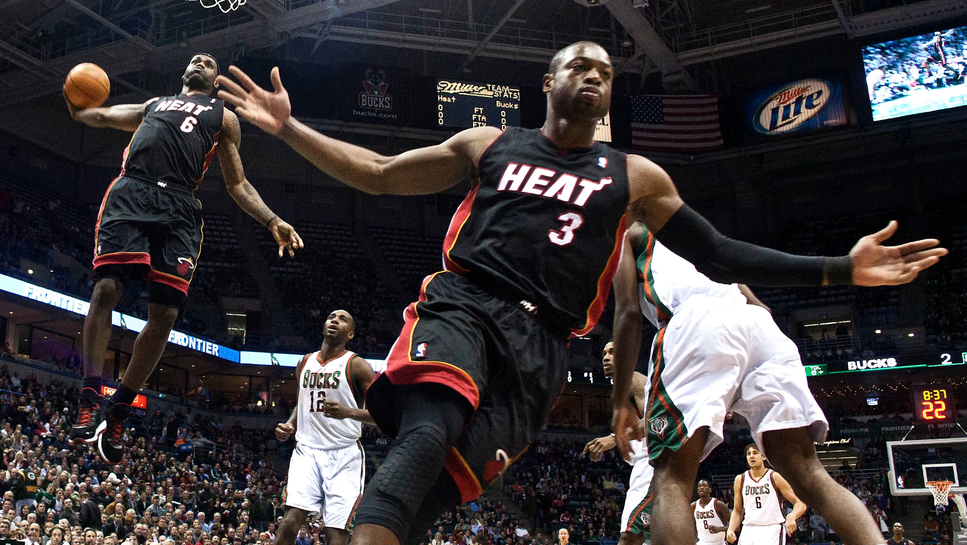
LIVE Demo

Slide 12
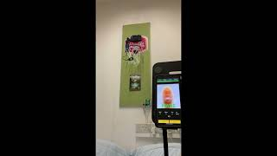
UNLIVE Demo

Slide 13
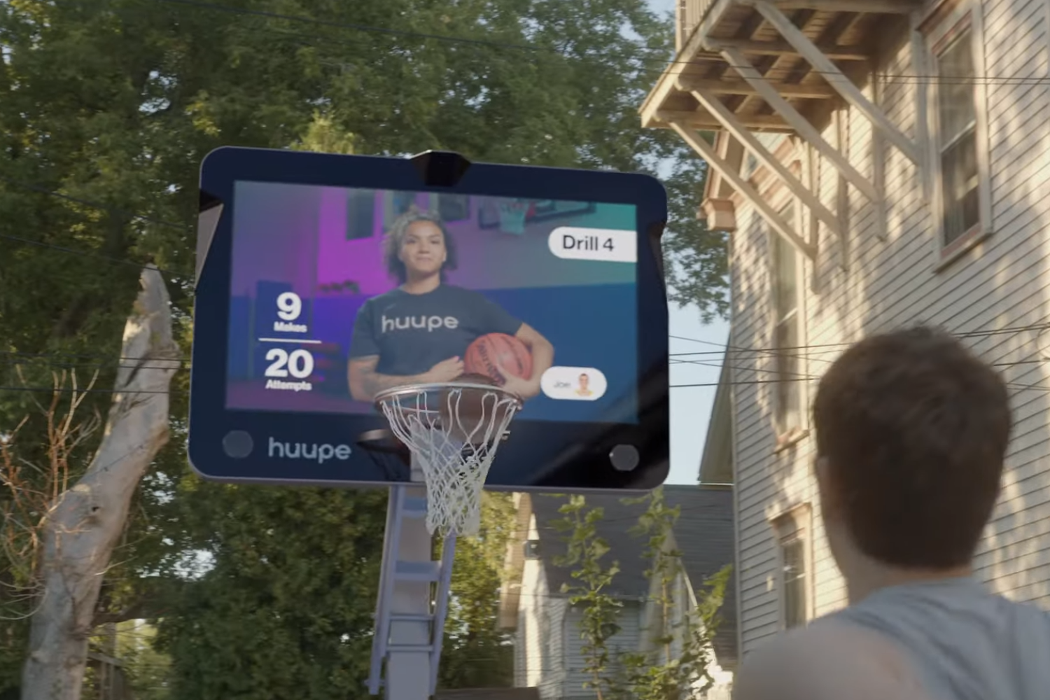

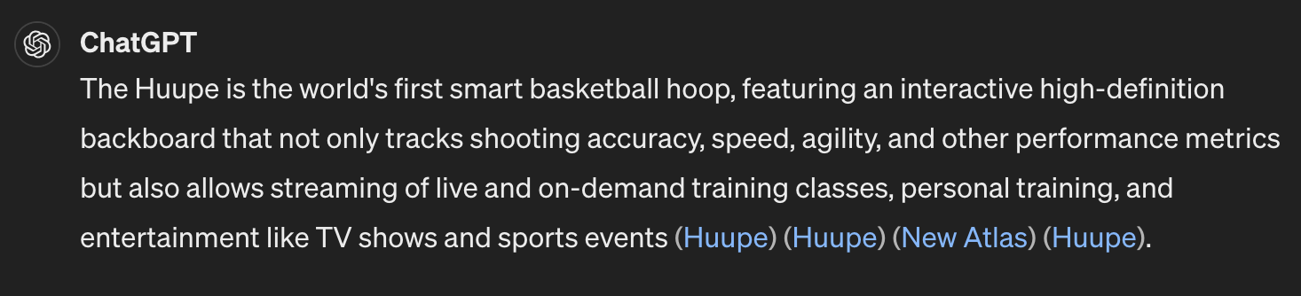
Conclusion
more sensors to enhance accuracy
leverage full capabilities of ML
more detailed insights
this has been done! shows potential!

Slide 14

Thank you!!
questions?

